Slide 1
Flight Price Prediction

Slide 2
Problem Statement
As the flight ticket prices so unpredictable and often cause anxiety when we would like to buy a ticket for our travel.
To solve this problem, which is caused by computers and algorithm behind for management of these in the systems, if we can unfold these algorithms and predict the price we can to some extent reduce the anxiety in the population.

Slide 3
Exploratory Data Analysis
Define the time and analysis the prices over time for best feature to feed to the algorithm
Scrapped the data from yatra and sky scanner determining/considering all possible features.

Slide 4
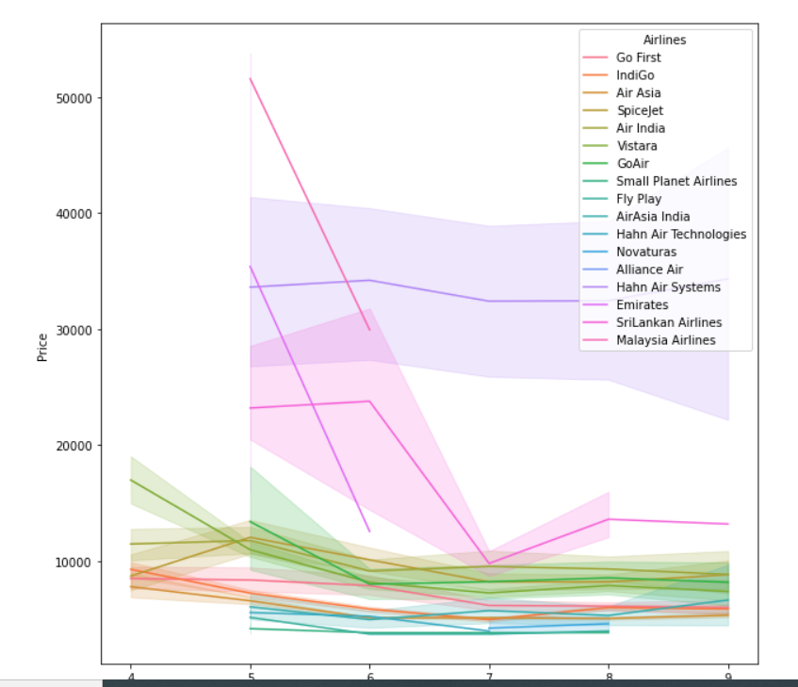
Understand the Price over days from departure date 1)The graphs shows data in 4, 5, 6, 7, 8 months 2)scrapped data every 10 days
Conclusion from above plot
1)Hahn Air systems are the costly airlines and change much with the Price , very constanly maintain the price over time
2)Srilankan Airlines and Emrites are the airlines which are costly when departure date is very close and are not available to book on the same day, As there was no data in April month available for booking
3)malaysia Airlines change fluctuate a lot with departure data and other factors
The price do not jump drastically when departure dates are close, there are closly when the arival date is very close and there move steadly
#Spice Jet is costly the indigo #fly pay are the cheapest airlines

Slide 5
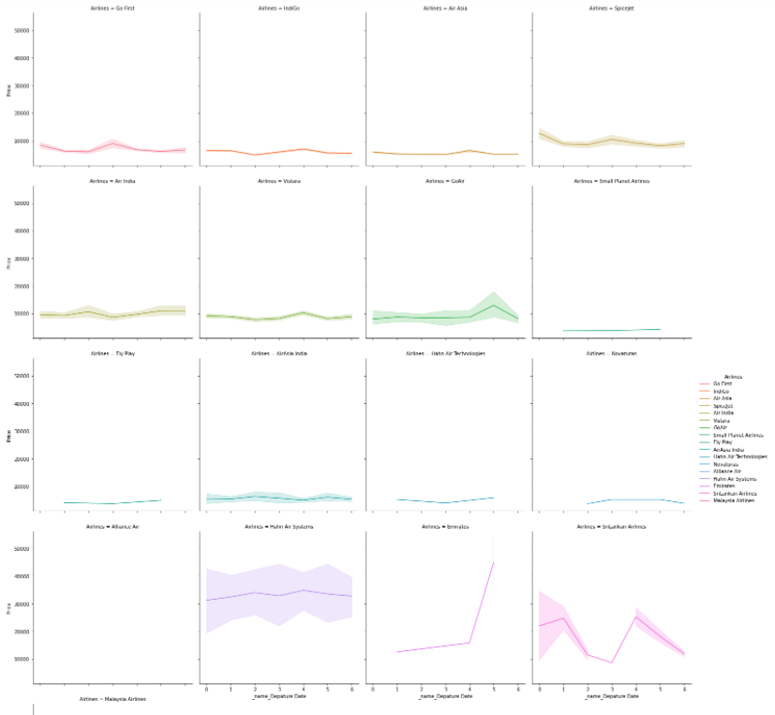
Understand the Price over weekdays Vs Weekends
0-Monday
6-Sunday

Slide 6
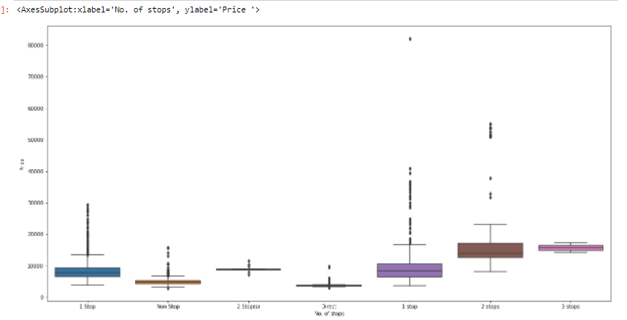
Also seen that direct flights ae less costly then 1 stop Vs 2 Stop Vs 3 stop

Slide 7
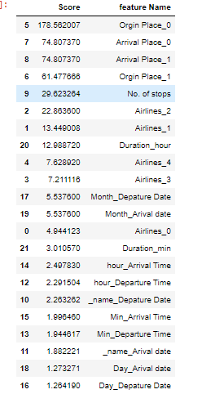
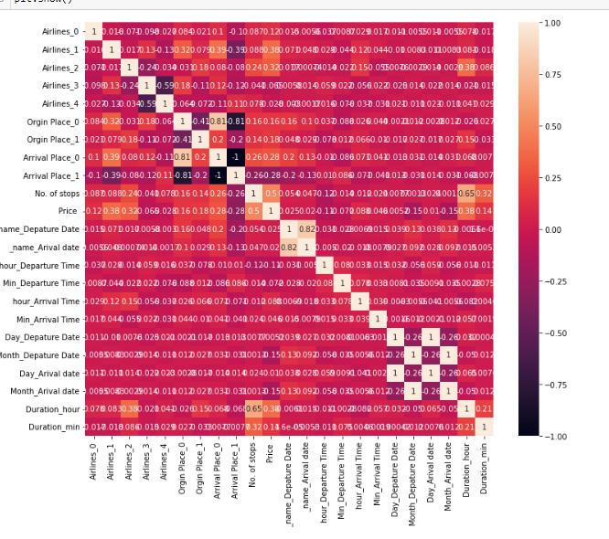
The best factors to determine Price are
Multicollinearity check

Slide 8
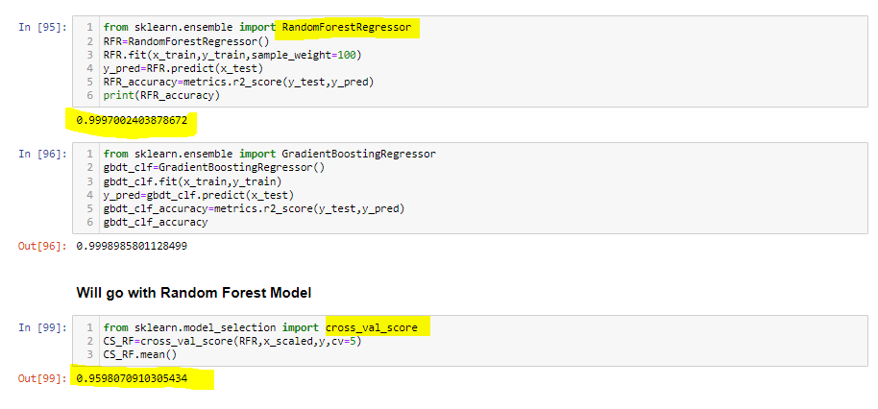
Checked that it’s the best model among multiple models

Slide 9
THANK YOU

